Slide 1
Futsal
Booking and Management
System
Presented by:
Aashish Rijal (79010939)
Dipesh Devkota (79010952)
Kedar Dhunagana (79010957)

Slide 2

Outline
Introduction
Problem Statement
Objectives
Scope and Limitations
Development Methodology
Requirement Analysis
System Architecture
Algorithm Details
Conclusion

Slide 3
Introduction
Our System is a web-based multi-tenant SaaS platform.
System enables users to search and book futsal courts online and forum
Allowing owners to manage bookings, schedules, pricing, and reviews through a centralized dashboard.
The logistic regression algorithm is used for sentiment analysis of user reviews.

Slide 4

Problem Statement
Manual bookings such as phone calls, handwritten records cause double booking.
Users struggle to find and compare futsal centers.
Difficulty managing bookings, schedules, and revenue for futsal owners.
Lack of proper analytics is leading to poor business decisions.

Slide 5
Objectives
To provide a centralized platform for futsal discovery and online court booking.
To simplify booking, scheduling and revenue management for futsal owners.
To provide booking analytics for better decision-making.

Slide 6
Scope Limitations
Search futsal centers by location, availability, and pricing
Owner dashboard for courts, time slots, pricing, and customers.
Community features: ratings, reviews, and discussion forums.
Location-based recommendation engine for nearby futsals.
Dependent on stable internet connectivity to function properly.
Mobile app support is limited in this initial phase (web-first).
Requires basic user training for owner and admin dashboards.

Slide 7
Literature Review
Suhaimi & Sahid (2021) – Digital Shift Recommends replacing manual booking records with digital systems.
Fauzi et al. (2022) – Operational Efficiency Web-based systems improve accessibility and reduce manual errors.
Modern System Design – SaaS Architecture Multi-tenant SaaS ensures scalability and secure data isolation.
Machine Learning Trends – AI & Analytics Logistic Regression and TF-IDF improve sentiment analysis and user insights

Slide 8
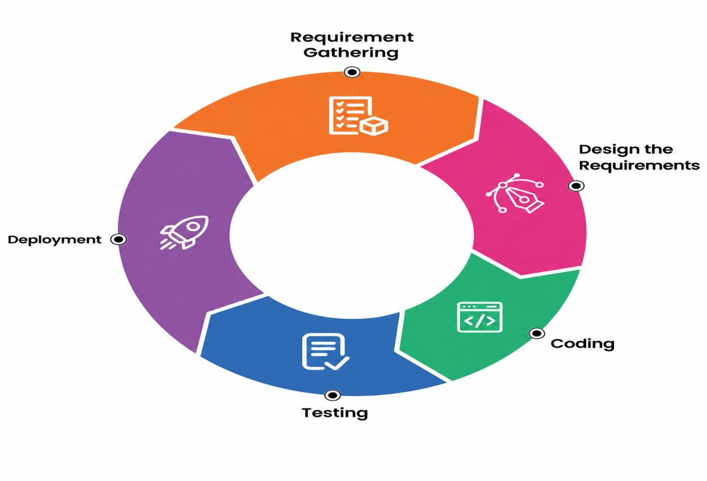
Development Methodology
Developed using the Agile methodology across five iterations, emphasizing flexibility, collaboration, and continuous feedback.

Slide 9
Requirement Analysis
Functional Requirements | Non-Functional Requirements
User Registration and Authentication | Usability-simple, clean interface fro all user roles.
Futsal discovery & search by location, price | Security-encrypted data, HTTPS, role-based access.
Booking with slot-conflict prevention | Performance- handles concurrent requests smoothly
Ratings, reviews & personalized court recommendations. | Maintainability-modular architecture, easy to update.
futsal owner dashboard: court, schedule, pricing | Reliability-accurate, consistent results every time.

Slide 10
Feasibility Study
Technical Feasibility Built using readily available and reliable technologies: React, Node, Redis, Scikit-learn, docker.
Economic Feasibility Developed at minimal cost using open-source technologies and free-tier cloud hosting services.
Operational Feasibility: Browser-based with no installation. Minimal training needed; owners just register and keep availability updated.
Schedule Feasibility Completed within 14 weeks across 10 phases, following Agile with overlapping tasks for timely delivery.

Slide 11
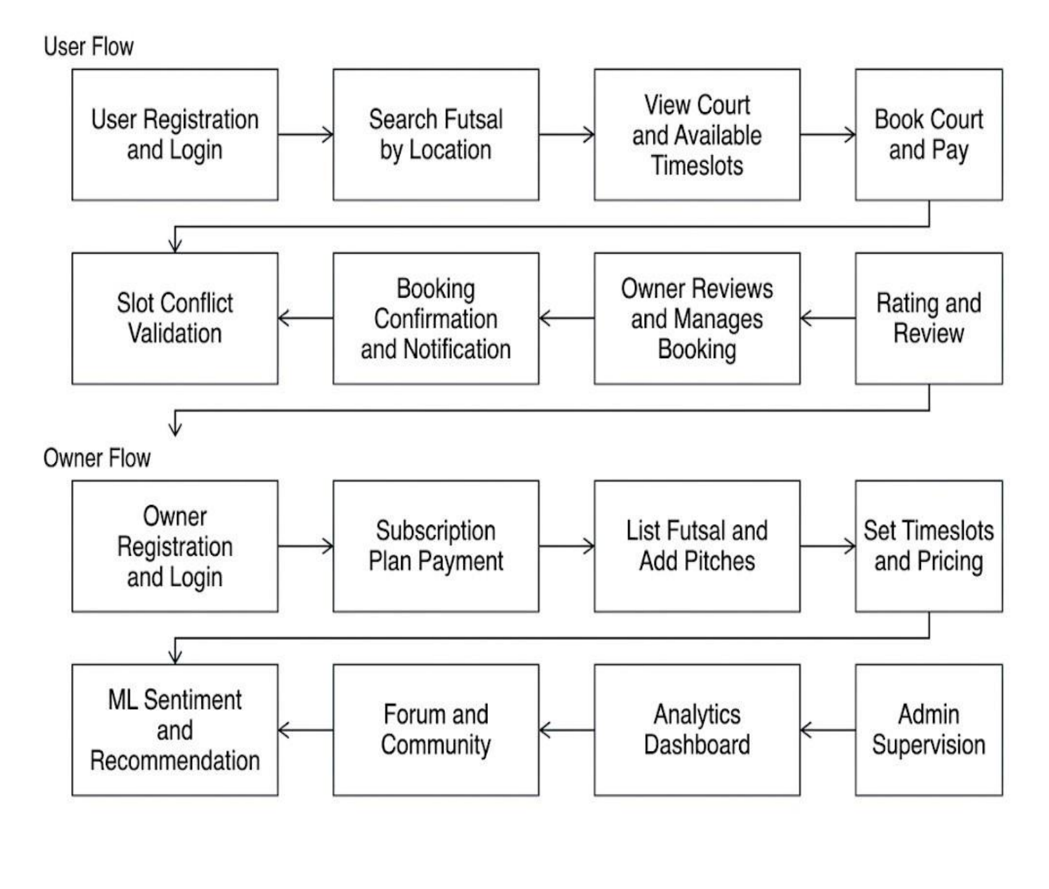
System Architecture

Slide 12
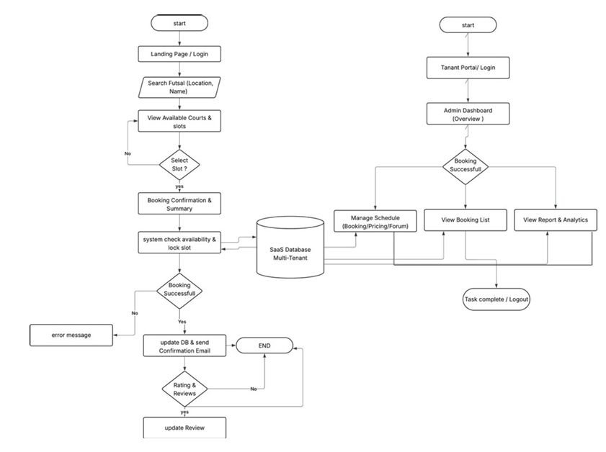
Workflow
of
the system

Slide 13
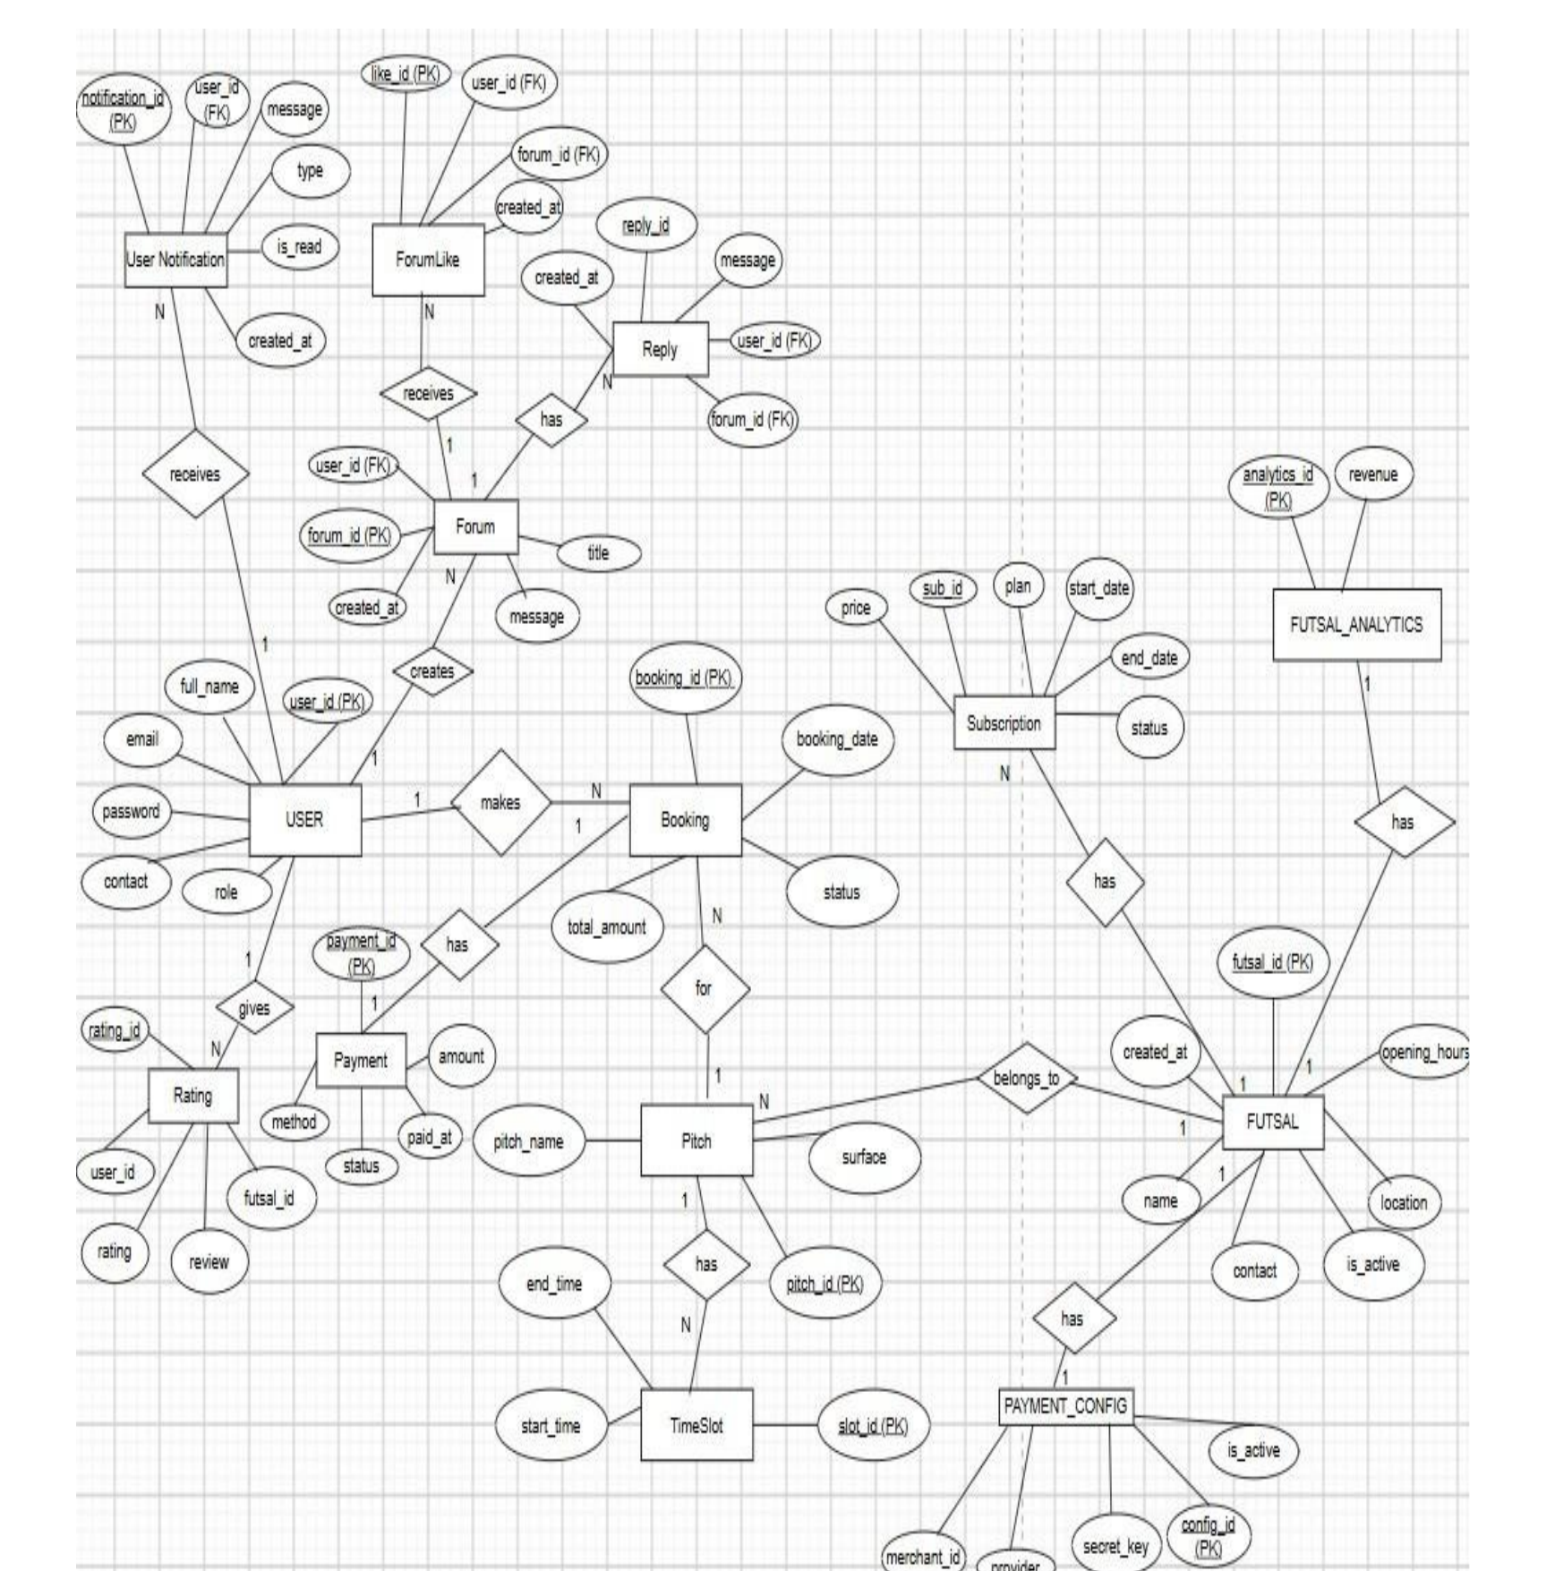
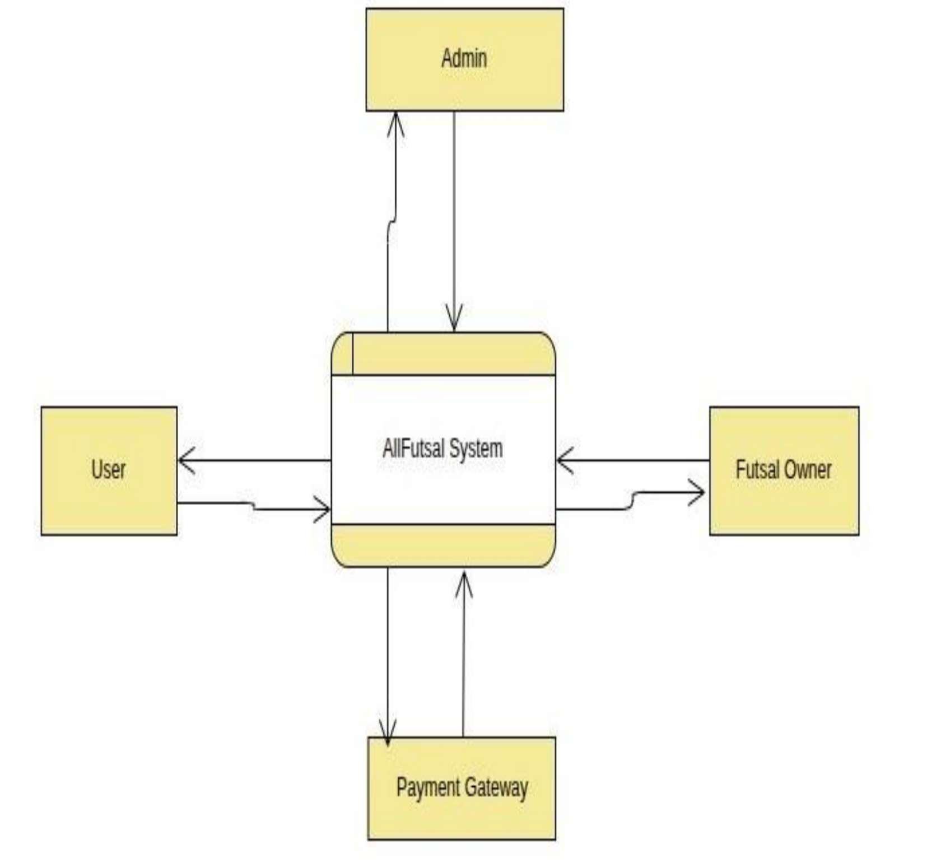
ER Diagram DFD level -0

Slide 14
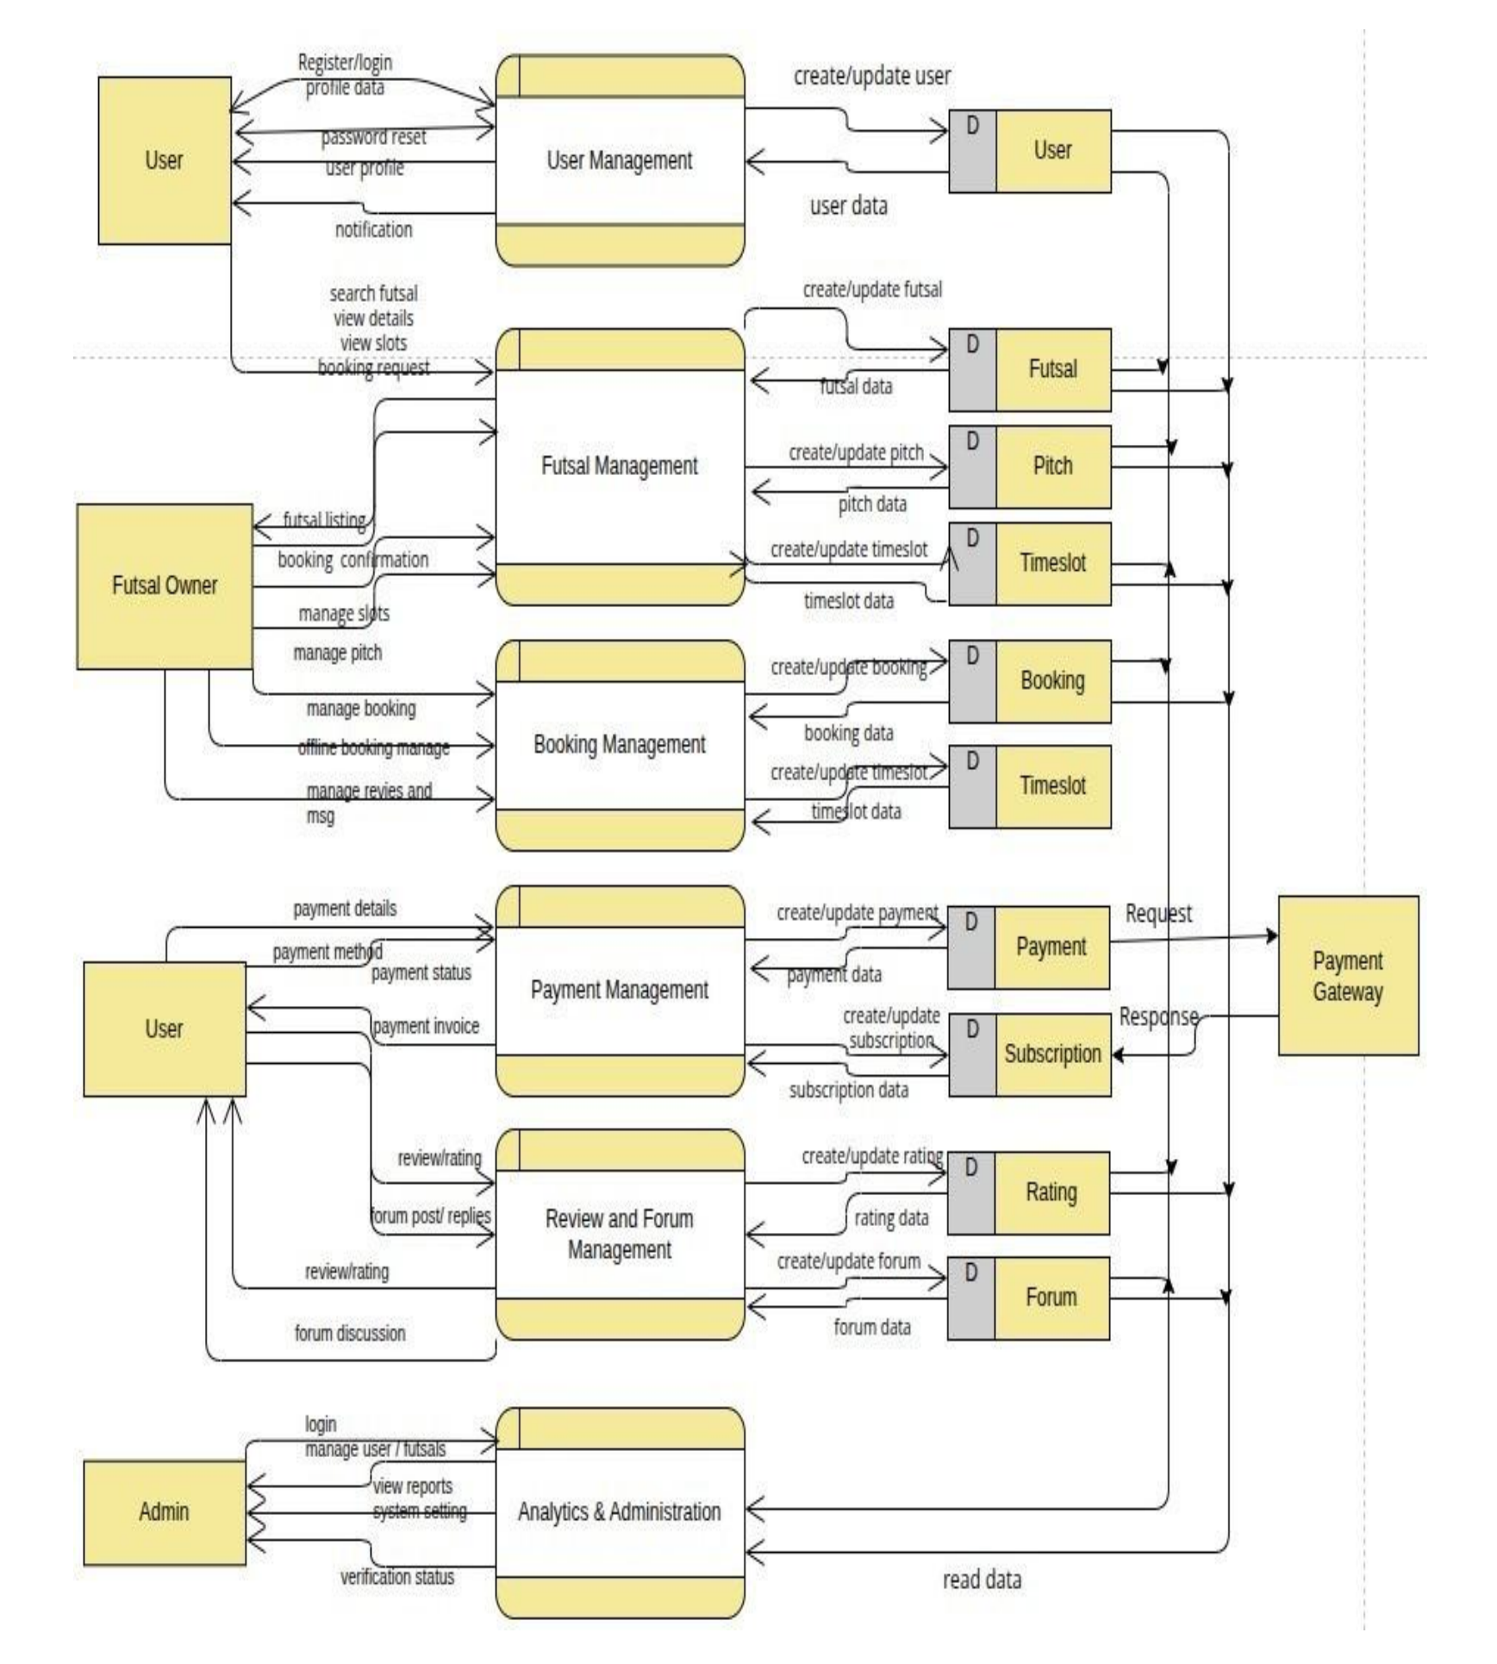
DFD level-1

Slide 15
Algorithm
A supervised classifier Logistic Regression that determines review sentiment. TF-IDF feature vectors from review text are passed through the trained model to output a Positive / Negative label.
Why Sentiment Analysis?
To automatically understand whether users are satisfied or dissatisfied with a futsal based on their reviews and use that information to improve recommendations.

Slide 16
Working of Algorithm
The sentiment of each futsal review is classified using Logistic Regression based on the TF-IDF feature
P(Positive) = 1 / (1 + e⁻ᶻ)
The weighted score z is calculated as:
z = (w₁ × x₁) + (w₂ × x₂) + ... + (wₙ × xₙ) + b
Where:
x₁, x₂, ..., xₙ = TF-IDF feature values
w₁, w₂, ..., wₙ = Learned model weights
b = Bias/intercept
P(Positive) ≥ 0.5 - Positive Review
P(Positive) < 0.5 - Negative Review
The predicted sentiment is then used to identify futsal venues with more positive user feedback and support the recommendation of suitable futsal venues.

Slide 17
Conclusion
Overall,our Futsal Booking and Management System provides a secure, efficient, and scalable platform for managing futsal businesses.
It reduces manual errors and double bookings while streamlining booking, revenue tracking, subscriptions, and customer communication.
Users benefit from real-time court discovery, instant confirmations, verified reviews, and proximity-based recommendations.
The integration of sentiment analysis provides AI-driven insights from user feedback, while the multi-tenant SaaS architecture supports future expansion and nationwide futsal management.

Slide 18
References
[1] A. N. S. Suhaimi and M. Z. Sahid, "A Development of Futsal Court Booking System," AITCS, vol. 4, no. 1, 2023.
[2] UiTM, "Progressive Web Applications for Mobile-First Systems," 2024.
[3] S. Nagar et al., "Logistic Regression Based Approach for Human Sentiment Analysis," ACROSET, 2024.
[4] IBM, "What is multi-tenant architecture?" Available: https://www.ibm.com/think/topics/multi-tenant

Slide 19

THANK YOU

